Slide 1
CARES Online Application

Slide 2
Completing the CACFP Application and Reimbursement Electronic System (CARES) Application process
Initial Overview

Slide 3
Pre-Application Information
Received by email
Pre-requisite to training
Submitted by email

Slide 4
Login Self-Registration

Slide 5
Login Authorization Form

Slide 6
NJ MAIN HOME PAGE (PORTAL TO CARES)

Slide 8
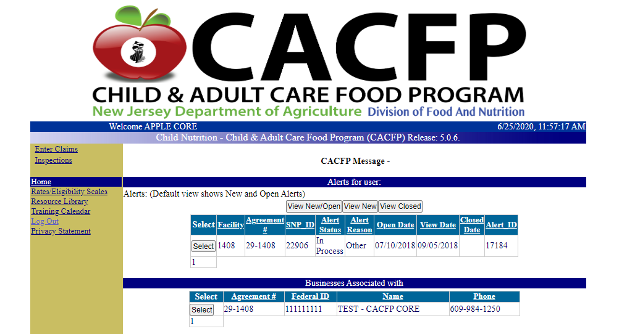
CARES HOME PAGE EXAMPLE

Slide 9
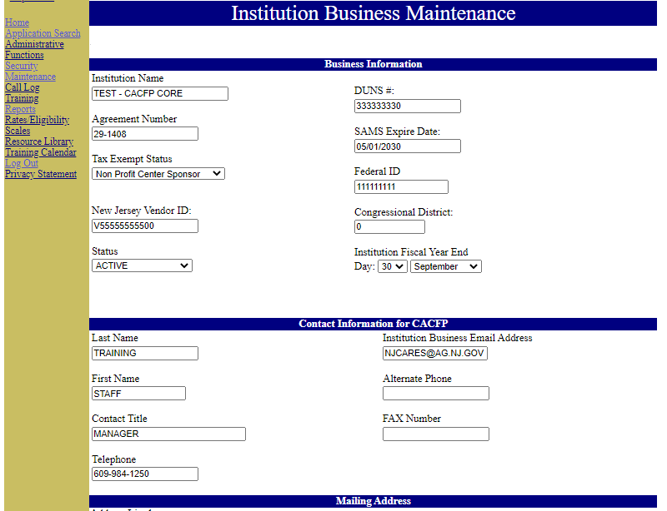

Slide 10
CARES 3 MAIN TABS
Applications
Facility Maintenance
Enter Claims

Slide 12
CACFP SAMPLE MENU
May 2019
* = Whole Grain Items

Slide 13
CARES Electronic Claims for Reimbursement

Slide 14
◆ Six Claiming Requirements
◆ Seven steps to Claim
◆ Common Error Messages
◆ Late Claims
◆ Adjusting a claim
OBJECTIVES

Slide 15
CARES Claiming Requirements
1. Approved CACFP CARES Application
2. “Active”
SAM
Registration
3. Approved Application for Center Facility Participation
4. Current
Facility License(s)
5. Submitter and Certifier User Logins
6. Submit and Certify Facility Claim Summary

Slide 16
1. Current Fiscal Year Approved Application
CARES Claims Requirements
Each year institutions are required to submit a CARES application for approval. If an institution application is not submitted and approved by CACFP program an institution will not be able to submit a claim in the CARES Claim module for that Fiscal year.
Requirements for Claim Submission
2. SAM Expiration Date will need to be current.
SAM Expiration Date on the Institution Business Maintenance page will need to be current or the CARES Claims system will not allow for submission of a claim.
Note: Access to SAM information should be Public. If not, the SA cannot verify the expiration and you will not be able to claim.

Slide 17
A Current Facility License is required for each facility or the CARES Claims system will not allow for submission of claim.
3. Facility License
CARES Claims Requirements (Cont.)
4. Application for Center Facility Participation
Each Application for Center Facility Participation must be current and approved before a claim can be submitted for that facility.
Updating the Operating and Revision Data (Schedule A) for each facility is completed in the CARES Application module within the Application for Center Facility Participation Section.

Slide 18
5. Submitter/Certifier Login ID
Each Institution will need a Submitter and a Certifier to complete a claim
submission.
NOTE: If you do not Certify a claim you will not receive reimbursement.
CARES Claims Requirements (Cont.)
6. Submitting/Certifying a Claim
Claims must be entered for each facility and then added to the monthly Claim summary. This claim summary must be submitted and certified before being processed for reimbursement.
Completed by two different log-ins:
Submitter - enters the meal claim data for each facility and adds this information to the monthly claim summary. The Submitter submits the monthly claim summary.
Certifier – verifies and certifies that the meal claim data submitted is accurate. The Certifier certifies the monthly claim summary.

Slide 19
7 Steps to Claim
Log in | Log into CARES as the submitter
Enter Claims | Enter Claims, Select Institution in Claims Module
Select Month | Select Claim Month and Claim Year
Enter Data | Enter Facility’s Claim data
Submit Data | View Claim Summary and Submit
Log in | Log into CARES as the certifier, Enter Claims and View Claim Summary
Certify | Certify Claim

Slide 20
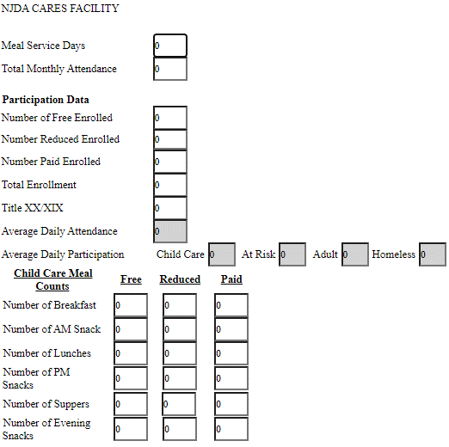

Slide 21
Common Error Messages
Number of breakfast exceeds maximum approved on facility application.
Number of days in operation can’t be greater than the number of operating days listed on
application.
Number of child care/ homeless suppers exceeds maximum approved on facility application.
Number of free supper is required.
Number of days in operation must be between 1 and 31.
Total monthly attendance may not be greater than total enrollment, number of meal service days.
Meal limitation provision edit check failed. You cannot claim more than 3 meals per child.
Warning: Average Daily Attendance is greater than Number of Children/Adults Enrolled (Free+Reduced+Paid). Please verify meals claimed before certifying claim.

Slide 22
Late Claim
◆ Claim is over 60 days old
◆ Certifier must complete a corrective action form
◆ Submit corrective action plan
◆ Late claim will be processed and the user will be notified via e-mail once completed.

Slide 23
Late Claim Alert Example
Note: USDA allows for the repayment of a late claim once every 36 months.

Slide 24
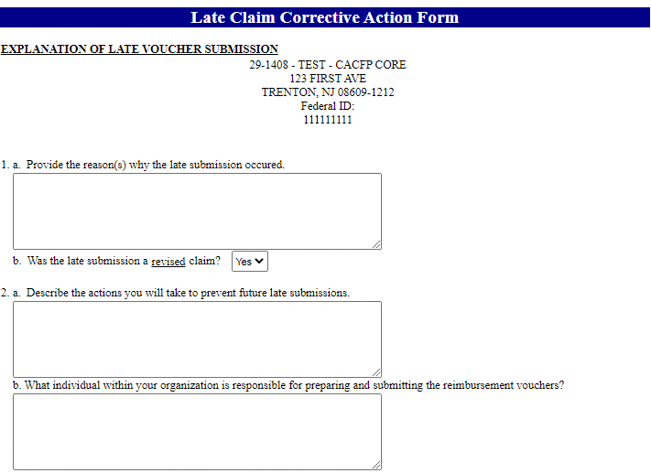
CORRECTIVE ACTION FORM

Slide 25
Adjusting a Claim Procedures
◆ Submitter must adjust a claim
◆ Adjustments can be made on a submitted claim once it is submitted. Adjustments made on certified claims are available once the claim is processed.
◆ Select Adjust button
◆ Input the any adjustments in the new claim listing grid
◆ Select the facility being adjusted and make changes
◆ Select Calculate and Add to claim summary
◆ Click View Claim Summary to submit adjustment
◆ Adjustment must be certified by the claims certifier

Slide 26
CARES Support
◆ CACFP Staff will be available for system support.
◆ Contact your Nutrition Program Specialist via e-mail or phone.
◆ Client Support: (609) 984-1250
NJCARES@ag.nj.gov

Slide 27
CONTACT YOUR PAYMENT SPECIALIST CHRISTINE JOHNSON
(609) 984-1266

Slide 28
DIRECTLY DEPOSITED
CONGRATULATIONS!!!

Slide 29
2. OBTAIN CARES APPLICATION APPROVAL
1. COMPLETE CARES ONLINE APPLICATION
NOW WHAT?
3. SCHEDULE PRE-APPROVAL

Slide 30
VCA Performance Standards
Financial Viability =
Financial Resources
Viability Capability Accountability
Administrative Capability = Staffing and Expertise
Program Accountability = Internal Controls

Slide 31
SHARED COMMITMENT TO COMPLIANCE
◆ Personal Integrity
◆ Understanding Requirements
◆ Maintaining Communication
◆ Doing the Right Thing …Every Time

Slide 32
RESOURCES

Slide 33
Education and Training Resources for CACFP Professionals
◆ CACFP MEAL PATTERN RESOURCES
◆ Research-based education and training resources designed to support CACFP professionals in successfully implementing the program’s requirements.
◆ Website:
https://theicn.org/cacfp

Slide 34
Team Nutrition
◆ Provide MyPlate materials developed specifically for kids and their parents/caregivers.
◆ Offer evidenced-based curricula that educators can use to integrate MyPlate lessons into core educational subjects, such as Math, English Language Arts, and Science.
◆ May request free printed copies of many of these materials. Materials available in print are on the website:
Websites: https://www.fns.usda.gov/tn/myplate https://www.choosemyplate.gov/

Slide 35
Utilize Handouts/Education Material
Find Balance Between Healthful Food and Fun Meal Activities

Slide 36
MyPlate, MyState
Connects Americans with the foods and flavors grown in their states and region
https://www.choosemyplate.gov/eathealthy/myplate-mystate/new-jersey

Slide 37
Farm to School
Schools can partner with NJ farmers to source more than 100 types of
Jersey Fresh produce grown here in the Garden State

Slide 38
Supplemental Nutrition Assistance Program Education (SNAP-Ed)
◆ Grant program funding projects in all US States and Territories
◆ Encompasses
Nutrition education
Social marketing
Policy, systems, and environmental change (PSE)
◆ Budget-Conscious Resources
The goal of SNAP-Ed is to improve the likelihood that persons eligible for SNAP will make healthy food and lifestyle choices that prevent obesity.
Website: https://snaped.fns.usda.gov/

Slide 39
Nutrition, Physical
Activity, and Electronic Media Use in CACFP
What are the biggest nutrition and wellness challenges for child care?
What do providers need to overcome these challenges?
What are the best ways for providers to receive training and resources?
Website: https://www.fns.usda.gov/nutrition- physical-activity-and-electronic-media-use-cacfp

Slide 40
Thank you!
Call your specialist with questions:
609.984.1250
Click here to start the quiz

